Slide 1
Text and Document Visualization
UNIT 4

Slide 2
INTRODUCTION
We now have huge resources of information; from libraries, to email archives, to all facets of applications running on the World Wide Web. Visualization is a great aid in analyzing such data.
We can visualize in many different ways things such as a blog, a wiki, a twitter feed, billions of words, a collection of papers, or a digital library.
Since visualizations are task dependent, we can look at what tasks are necessary for dealing with text, documents, or web-based objects.

Slide 3
CONTD.
For text and documents, the most obvious tasks are searching for a word, phrase, or topic.
For partially structured data, we may search for relationships between words, phrases, topics, or documents.
For structured text or document collections, the key task is most often searching for patterns and outliers within the text or documents.
In this chapter we focus on visualization tasks dealing with text, and the various approaches to the visual analysis of text.

Slide 4
CONTD.
We define a collection of documents as a corpus (plural corpora). We deal with objects within corpora.
These objects can be words, sentences, paragraphs, documents, or even collections of documents. We may even consider images and videos.
Often these objects are considered atomic with respect to the task, analysis and visualization. Text and documents are often minimally structured and may be rich with attributes and metadata, especially when focused in a specific application domain.

Slide 5
CASE STUDY
Documents have a format and often include metadata about the document (i.e., author, date of creation, date of modification, comments, size).
Information retrieval systems are used to query corpora, which requires computing the relevance of a document with respect to a query.
This requires document pre processing and interpretation of the semantics of text. We can compute statistics about documents.
For example, the number of words or paragraphs, or the word distribution or frequency all can be used for author authenticity. Are there any paragraphs that repeat the same words or sentences? We can also identify relationships between paragraphs or documents within a corpus.

Slide 6
LEVELS OF TEXT REPRESENTATION
We define three levels of text representation:
1. Lexical
2. Syntactic
3. Semantic.
“Each requires us to convert the unstructured text to some form of structured data.”

Slide 7
LEXICAL
The lexical level is concerned with transforming a string of characters into a sequence of atomic entities, called tokens.
Lexical analysers process the sequence of characters with a given set of rules into a new sequence of tokens that can be used for further analysis.
Tokens can include characters, character n-grams, words, word stems, lexemes, phrases, or word n-grams, all with associated attributes.
Many types of rules can be used to extract tokens, the most common of which are finite state machines defined by regular expressions.

Slide 8
Syntactic level.
The syntactical level deals with identifying and tagging (annotating) each token’s function. We assign various tags, such as sentence position or whether a word is a noun, expletive, adjective, dangling modifier, or conjunction.
Tokens can also have attributes such as whether they are singular or plural, or their proximity to other tokens. Richer tags include date, money, place, person, organization, and time.
The process of extracting these annotations is called named entity recognition (NER). The richness and wide variety of language models and grammars (generative, categorical, dependency, probabilistic, and functionalist) yield a wide variety of approaches.

Slide 9
Semantic level.
The semantic level encompasses the extraction of meaning and relationships between pieces of knowledge derived from the structures identified in the syntactical level.
The goal of this level is to define an analytic interpretation of the full text within a specific context, or even independent of context

Slide 10
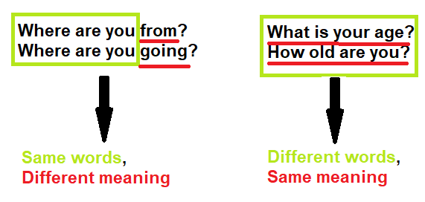
VECTOR SPACE MODEL
Vector space models are algebraic models that are often used to represent text (although they can represent any object) as a vector of identifiers. With these models, we are able to identify whether various texts are similar in meaning, regardless of whether they share the same words.

Slide 11
CONTD.
There are numerous instances we may decide to employ a vector spaced model, for instance:
1. Information Filtering
2. Information Retrieval
3. Machine Translation
4. Chatbots
And many more!
In general, Vector space models allow us to represent words and documents as vectors.

Slide 12
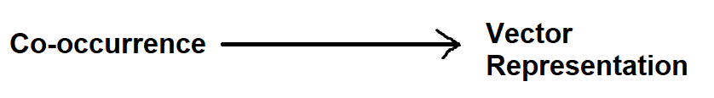
Word By Word & Word By Doc
For us to represent our text as vectors we may decide to use a word-by-word or word-by-doc design. Performing this task involves first creating a co-occurrence matrix.
Although how we perform each task is quite similar, we will discuss each design one at a time, nonetheless, the objective is the same. We want to go from our co-occurrence matrix to a vector representation.

Slide 13
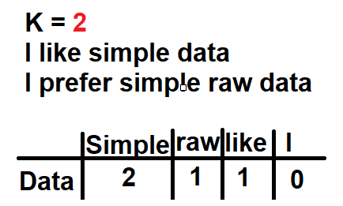
WORD BY WORD METHOD
Word By Word: This design counts the number of times words occur within a certain distance k.
In the word by word design, the co-occurrence matrix is between 1 and N entries.

Slide 14
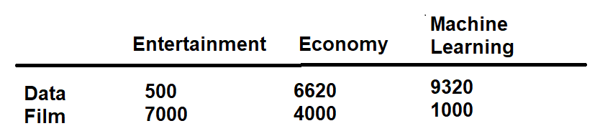
WORD BY DOC
Word By Doc: The number of times words from the vocabulary appear in documents that belong to certain categories.

Slide 15
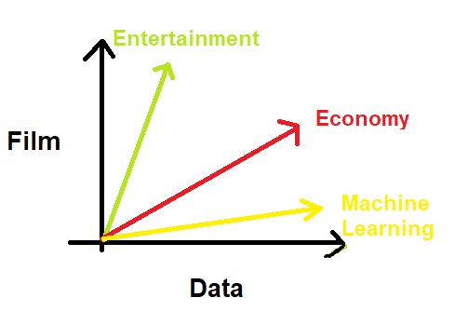
VECTOR REPRESENTATION
Using these vector representations, we can now represent our text or documents in vector space. This is perfect because in vector space we can determine the relationships between types of documents, such as their similarity.

Slide 16
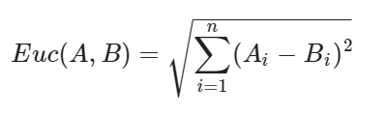
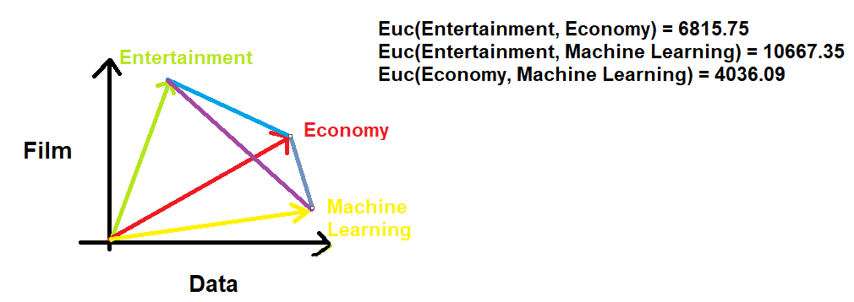
EUCLIDEAN DISTANCE
A similarity metric we may use to determine how far apart 2 vectors are from one another is the Euclidean distances, which is merely the length of a straight line that connects 2 vectors.

Slide 17
RESULT
The results tell us that the economy and Machine learning documents are more similar since distance-based metrics prioritize objects with lower values to detect similarity.
With that being said, it is important to note that the euclidean distance is not scale-invariant and it’s often recommended to scale your data.

Slide 18
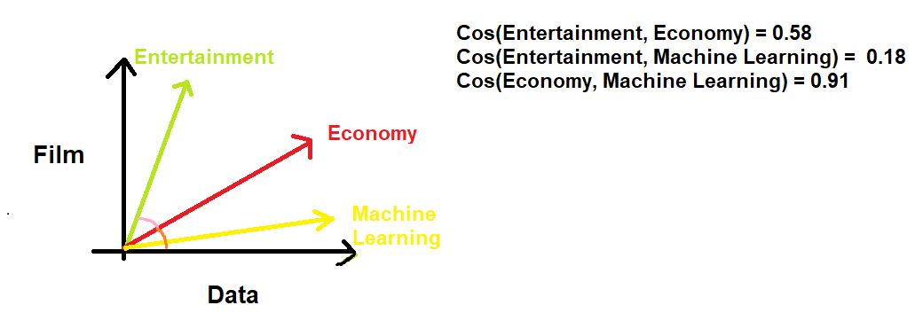
COSINE SIMILARITY
The problem with the Euclidean distance is that it is biased by size difference in representations. Therefore, we may decide to use the cosine similarity which would determine how similar text is using the inner angle. Cosine similarity is one of the most popular similarity metrics used in NLP. To calculate similarity, we take the cosine similarity of an angle between two vectors.

Slide 19
INFERENCES
When the cosine value is equal to 0 this means the two vectors are orthogonal to one another and have no match. Whereas, a cosine value closer to 1 would imply that there is a greater match between the two values (since the angles are smaller).
Therefore, from our results, Economy and Machine Learning are the most similar

